Slide 1



Slide 2
Fake

Slide 3
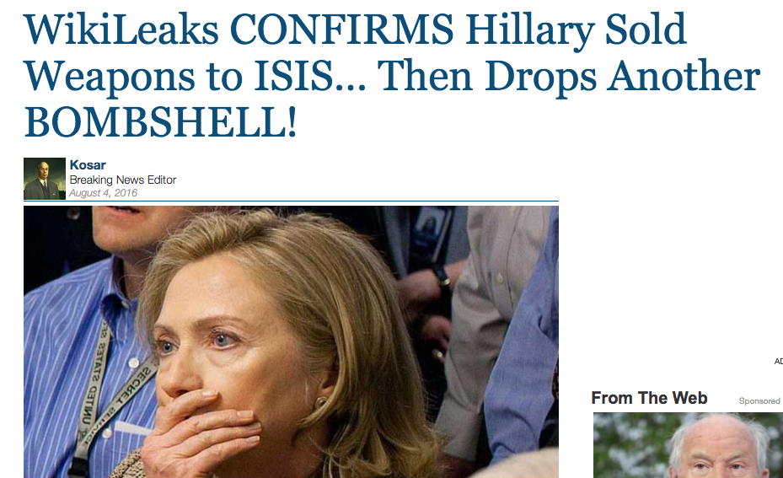

Slide 4
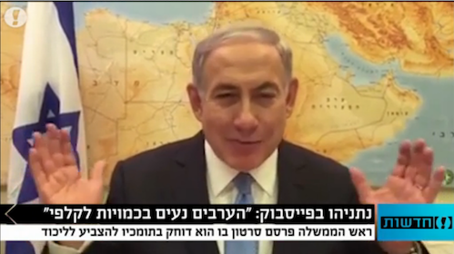

Slide 5
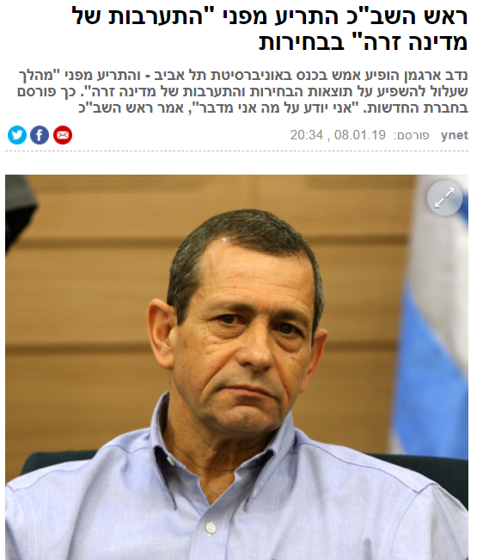
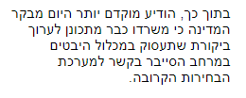
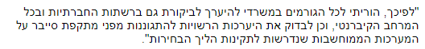

Soon to be seen again in our own back yard…

Slide 6
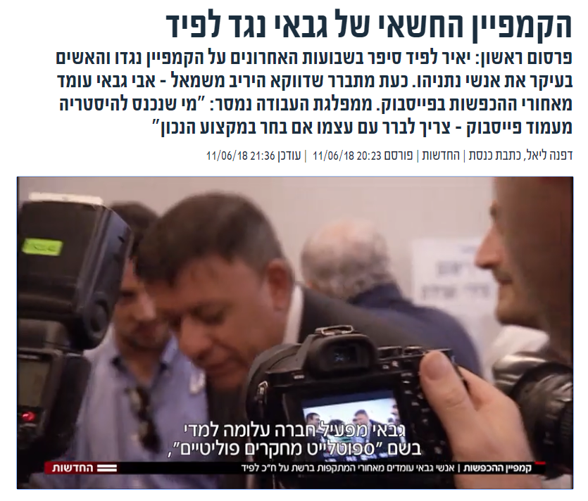

Slide 7



Slide 8


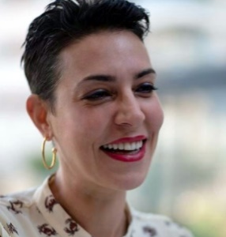

We are FakeWatch
Yoav Ast
CDO Product Manager
Yael Szafran CMO Planning and story telling
Omri Stayer CTO
Developer

Slide 9





Agenda
Business
Data Processing
Modeling & Results
Future Growth

Slide 10
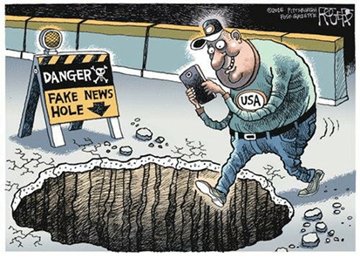
People are not very good at spotting fake news

Slide 11
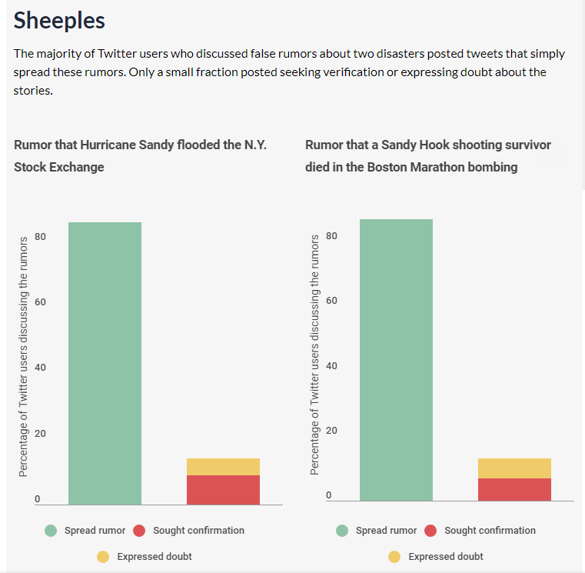
Because they don’t seek confirmation for stories

Slide 12
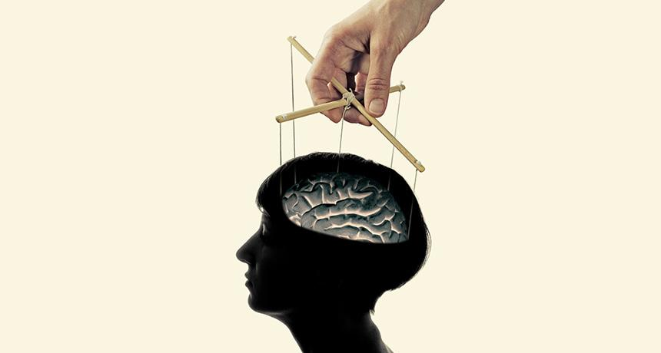
Easy to manipulate in the digital era

Slide 13
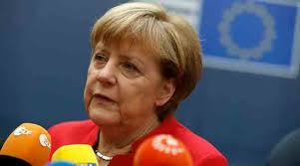
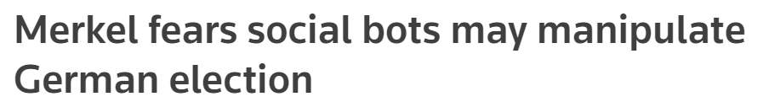
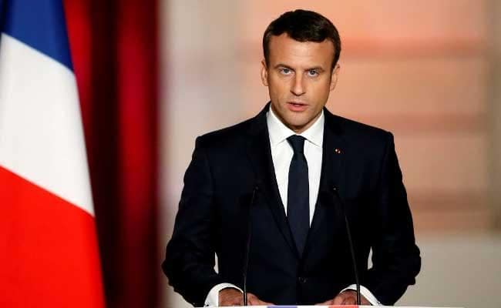
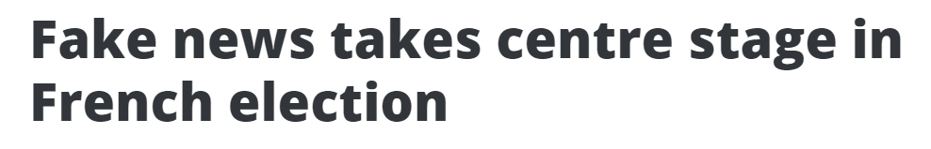
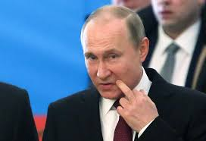
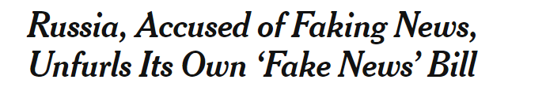

Slide 14
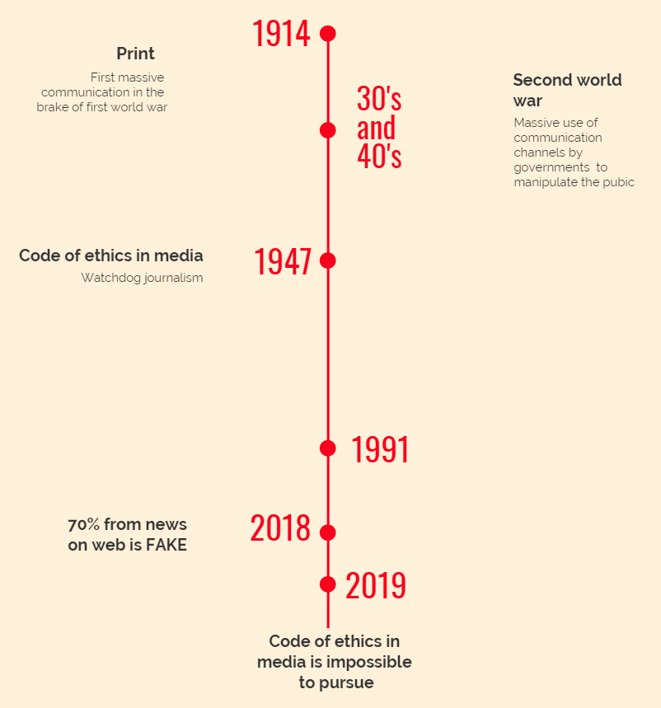



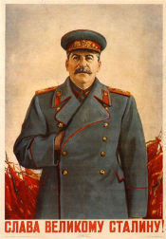



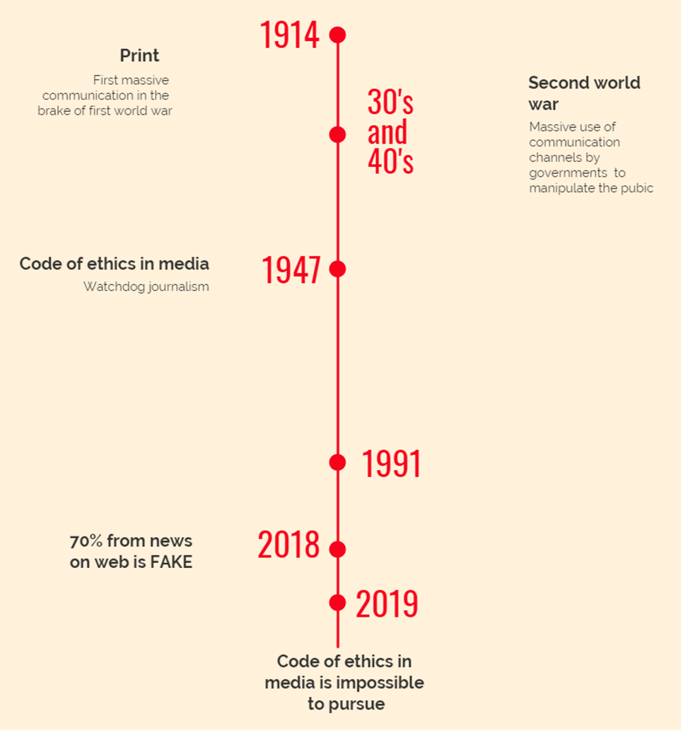


Dark propaganda
World leaders fear fake news
Dark propaganda

Slide 15
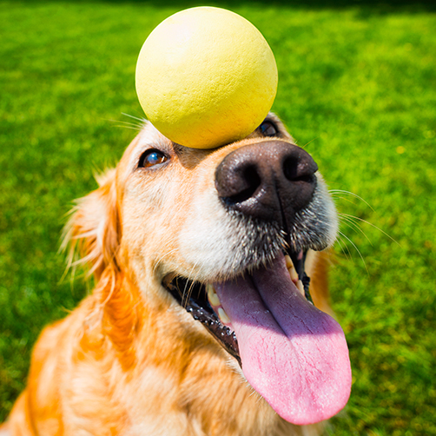
Watchdog journalism
2019

Slide 16
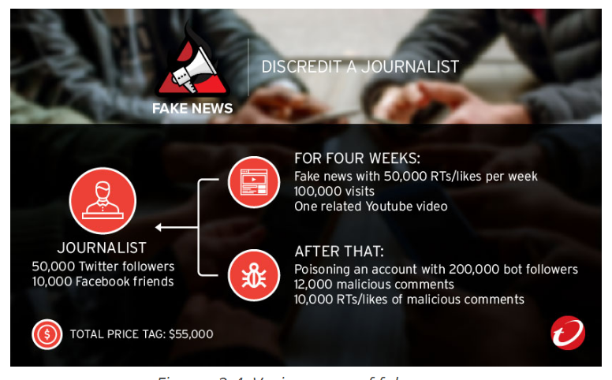

Slide 17

Vision & Mission
Monitoring & Detecting
Real-time Fake News
Protect society and businesses from harmful manipulation using machine learning algorithms

Slide 18


Business
Fake News Targeted Detection – B2B
Businesses
Individuals
Chrome Extension – B2C
Fake detector, the FakeWatch Alarm

Slide 19

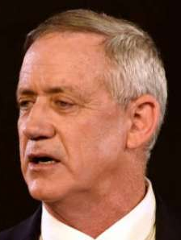
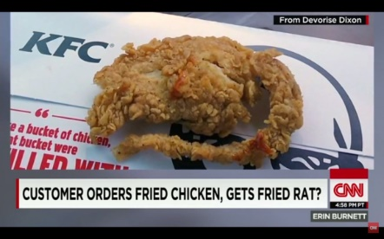
Business – B2B
Fake News Targeted Detection
Businesses
Individuals
Private
Corporate Reputation attacks
Gov
Public opinion manipulation, antisemitism and terror

Slide 20

Our business guideline is to seek High Recall

Slide 21
Business – B2C
Chrome Extension
Fake detector, the FakeWatch Alarm

Slide 22
Moral and Social value
Don’t be a FOOL
Provoking Critical Thinking
Don’t FAKE it
Promoting Social Change

Slide 23


Slide 24



Fake News DB
4000 Articles
Head
Body
URL
Fake/Real
DB Enrichment
21177 Articles
Additional DBs
Newspaper API
92,738,400 Words
2
1

Slide 25
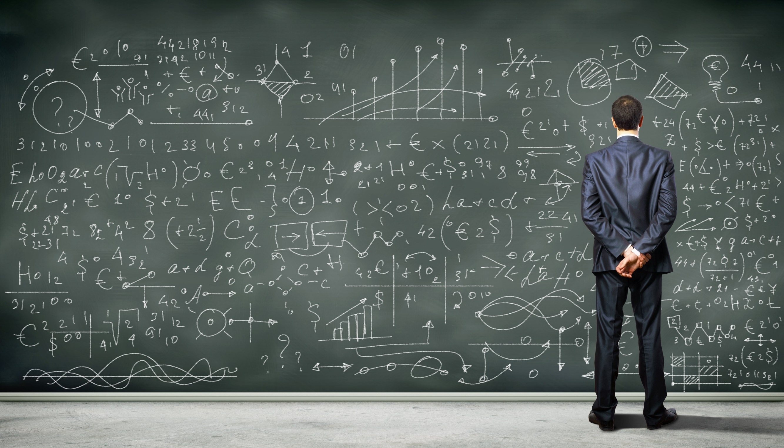

Slide 26

Fake News DB
4000 Articles
Head
Body
URL
Fake/Real
DB Upgrade
21177 Articles
Additional DBs
Newspaper API
EDA & Features
Length of Text
NLP
Punctuation !, ?, &
3
2
1

Slide 27
Features
Frequently used words
Head Body Length
Fake or Real?
Punctuation Marks
(!, &, ?)

Slide 28
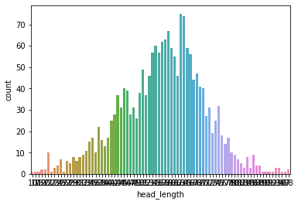
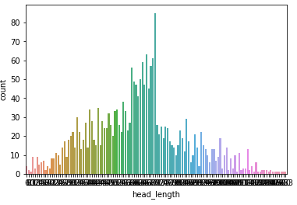
Body Length
Fake News have shorter body text
AVG 3554 words
AVG 2375 words

Slide 29
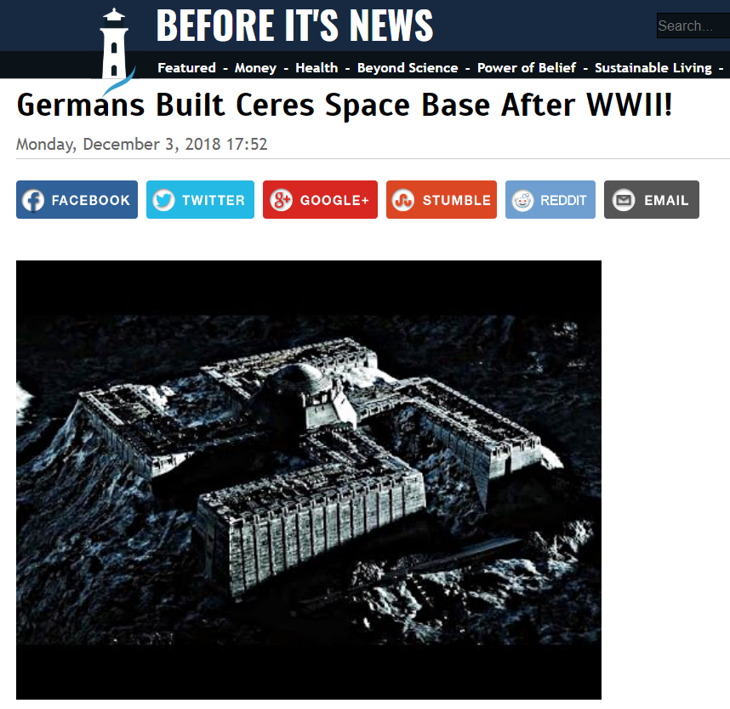
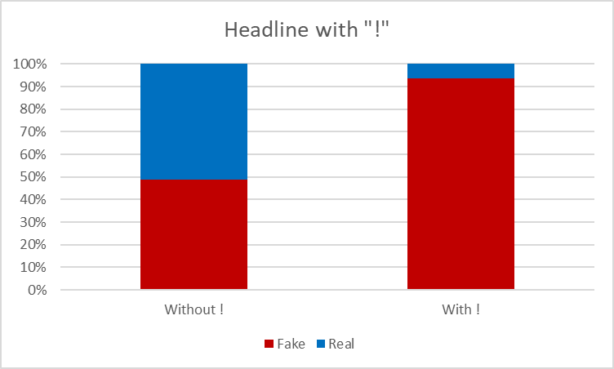
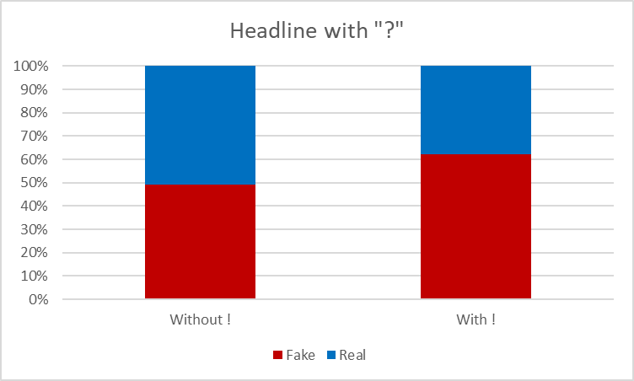
!
?
&
_{94% Fake}
_{62% Fake}
_{93% Fake}

Slide 30
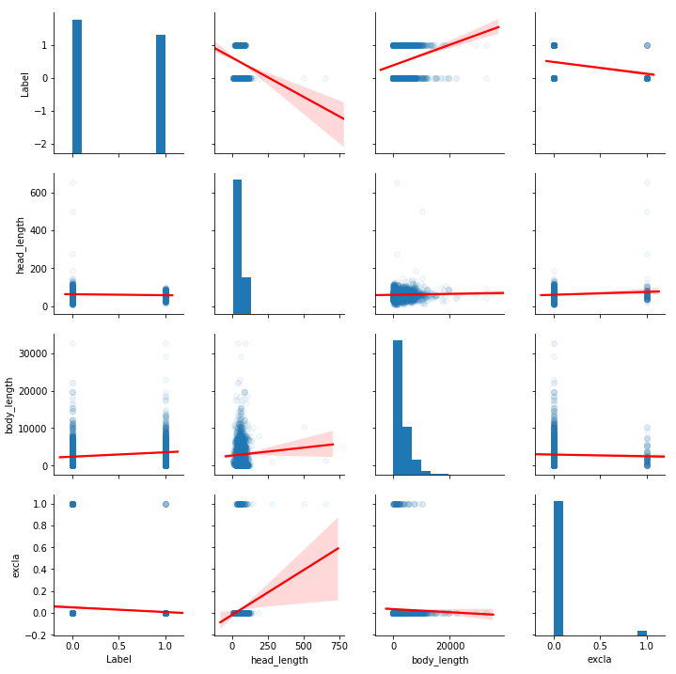
Predicting Fake News
Excla in Head ~ Fake news
Long body text ~ Real news
Longer Header ~ Fake news

Slide 31
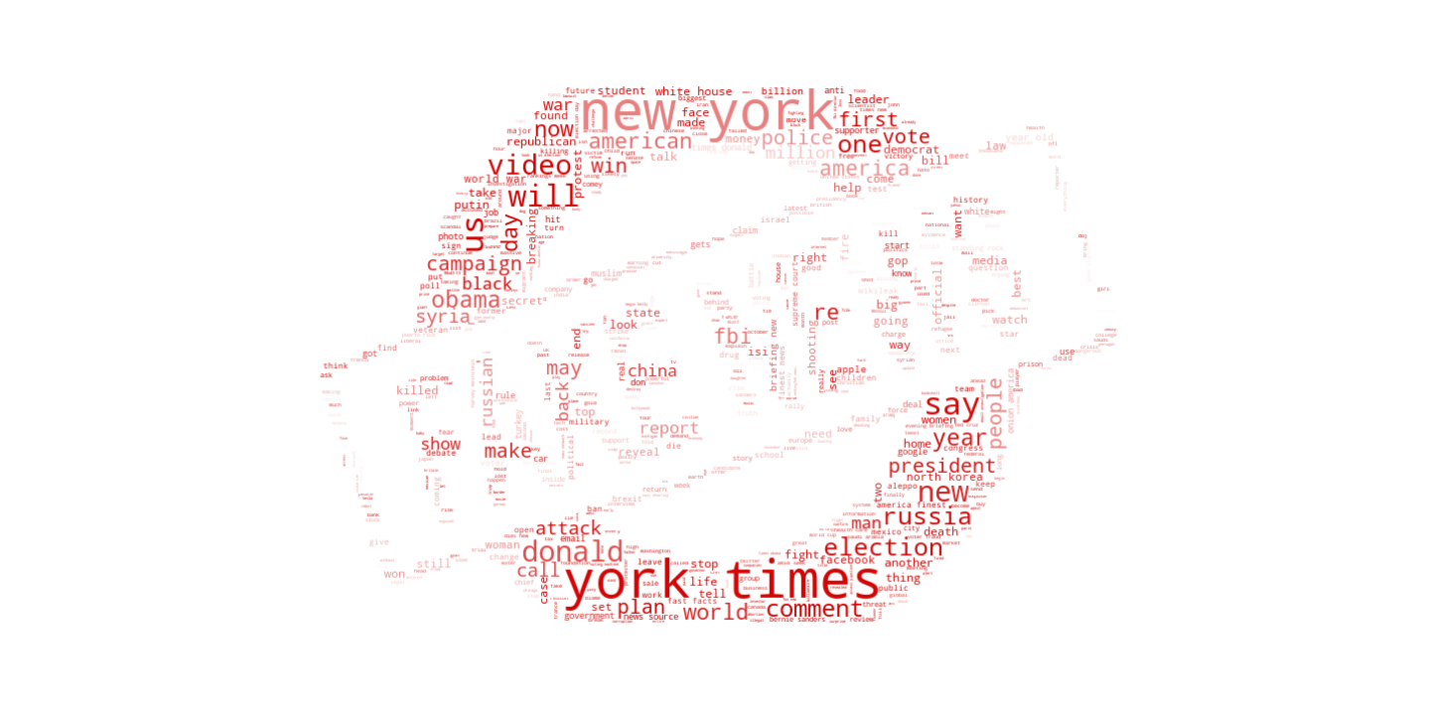
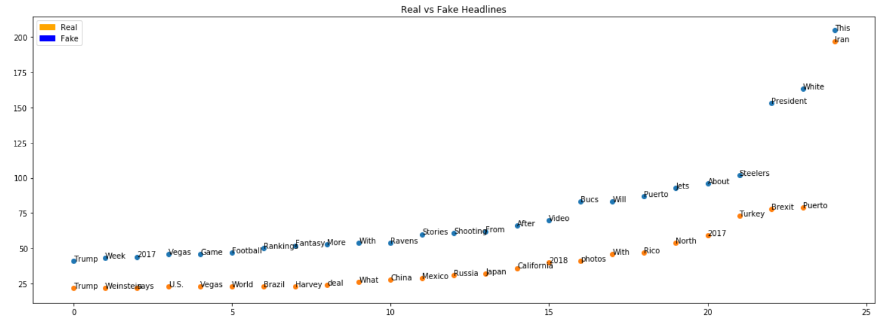

Slide 32
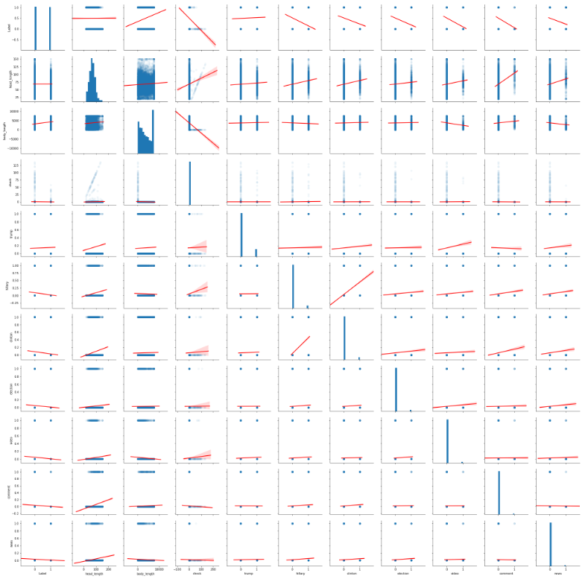
Predicting Fake News
New in Heading – 94%
President in Heading – 80%

Slide 33

Fake News DB
4000 Articles
Head
Body
URL
Fake/Real
DB Upgrade
21177 Articles
Additional DBs
Newspaper API
EDA & Features
Length of Text
NLP
Punctuation !, ?, &
Modeling & Results
Small tree
Large tree
RF & GBM
4
3
2
1

Slide 34
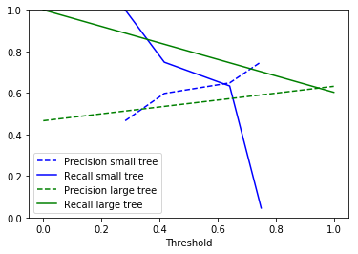
Our business guideline is to seek high recall

Slide 35
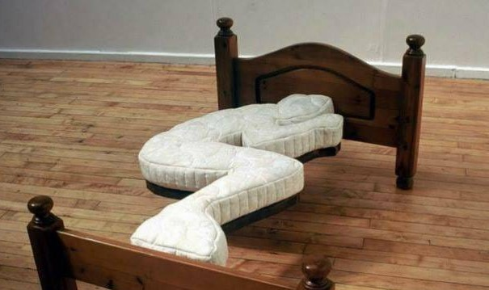
Results
Model | Classification Results
 | Score | Recall
Small Tree | 0.7 | 0.81
Large Tree | 0.8 | 0.77
Random Forest | 0.88 | 0.88
GBM | 0.87 | 0.84

Slide 37
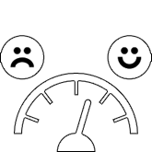

Fake News DB
4000 Articles
Head
Body
URL
Fake/Real
DB Upgrade
21177 Articles
Additional DBs
Newspaper API
EDA & Features
Length of Text
NLP
Punctuation !, ?, &
Modeling & Results
Small tree
Large tree
RF & GBM
Sentiment Analysis
5
4
3
2
Google Cloud
1

Slide 38



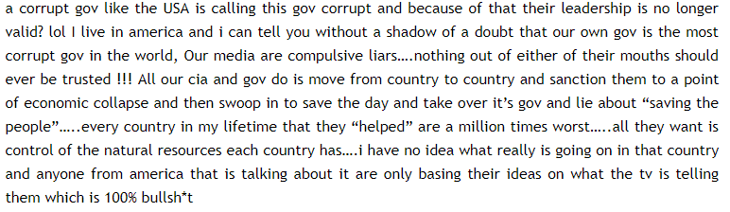
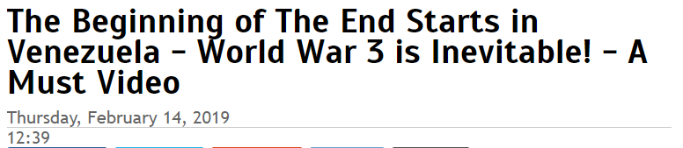
Sentiment Analysis
Negative Title
Neutral Text

Slide 39
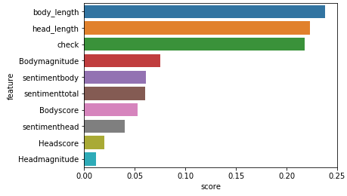
Results
Most Valuable Features:
Head/Body Length & Ratio
Body Magnitude
Body Sentiment
Total Sentiment
Head Score
Without Sentimentz
Model | Classification Results
 | Score | Recall
Small Tree | 0.7 | 0.81
Large Tree | 0.8 | 0.77
Random Forest | 0.87 | 0.78
GBM | 0.87 | 0.83
Adding Sentiment Analysis
Model | Classification Results
 | Accuracy | Recall
Small Tree | 0.60 | 0.65
Large Tree | 0.69 | 0.69
Random Forest | 0.8 | 0.93
GBM | 0.74 | 0.85
HeadbodyRatio

Slide 40


The Trump Test
Accuracy: 75
Recall : 94
Train
Test

Slide 41


Slide 42


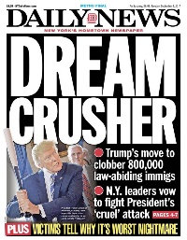
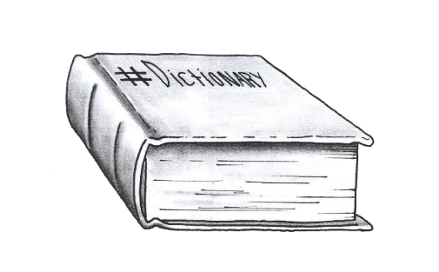


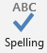
Future
Daily News Crawler
Named Entity Recognition
Grammar & Dictionary
Languages
Social Network / IM

Slide 43


Thank You
Omri Shtayer
Shtayeromri@Gmail.com
Yoav Ast
Yoav.ast@gmail.com
Yael Saffran
office@yaelsaffron.com

